Slide 1
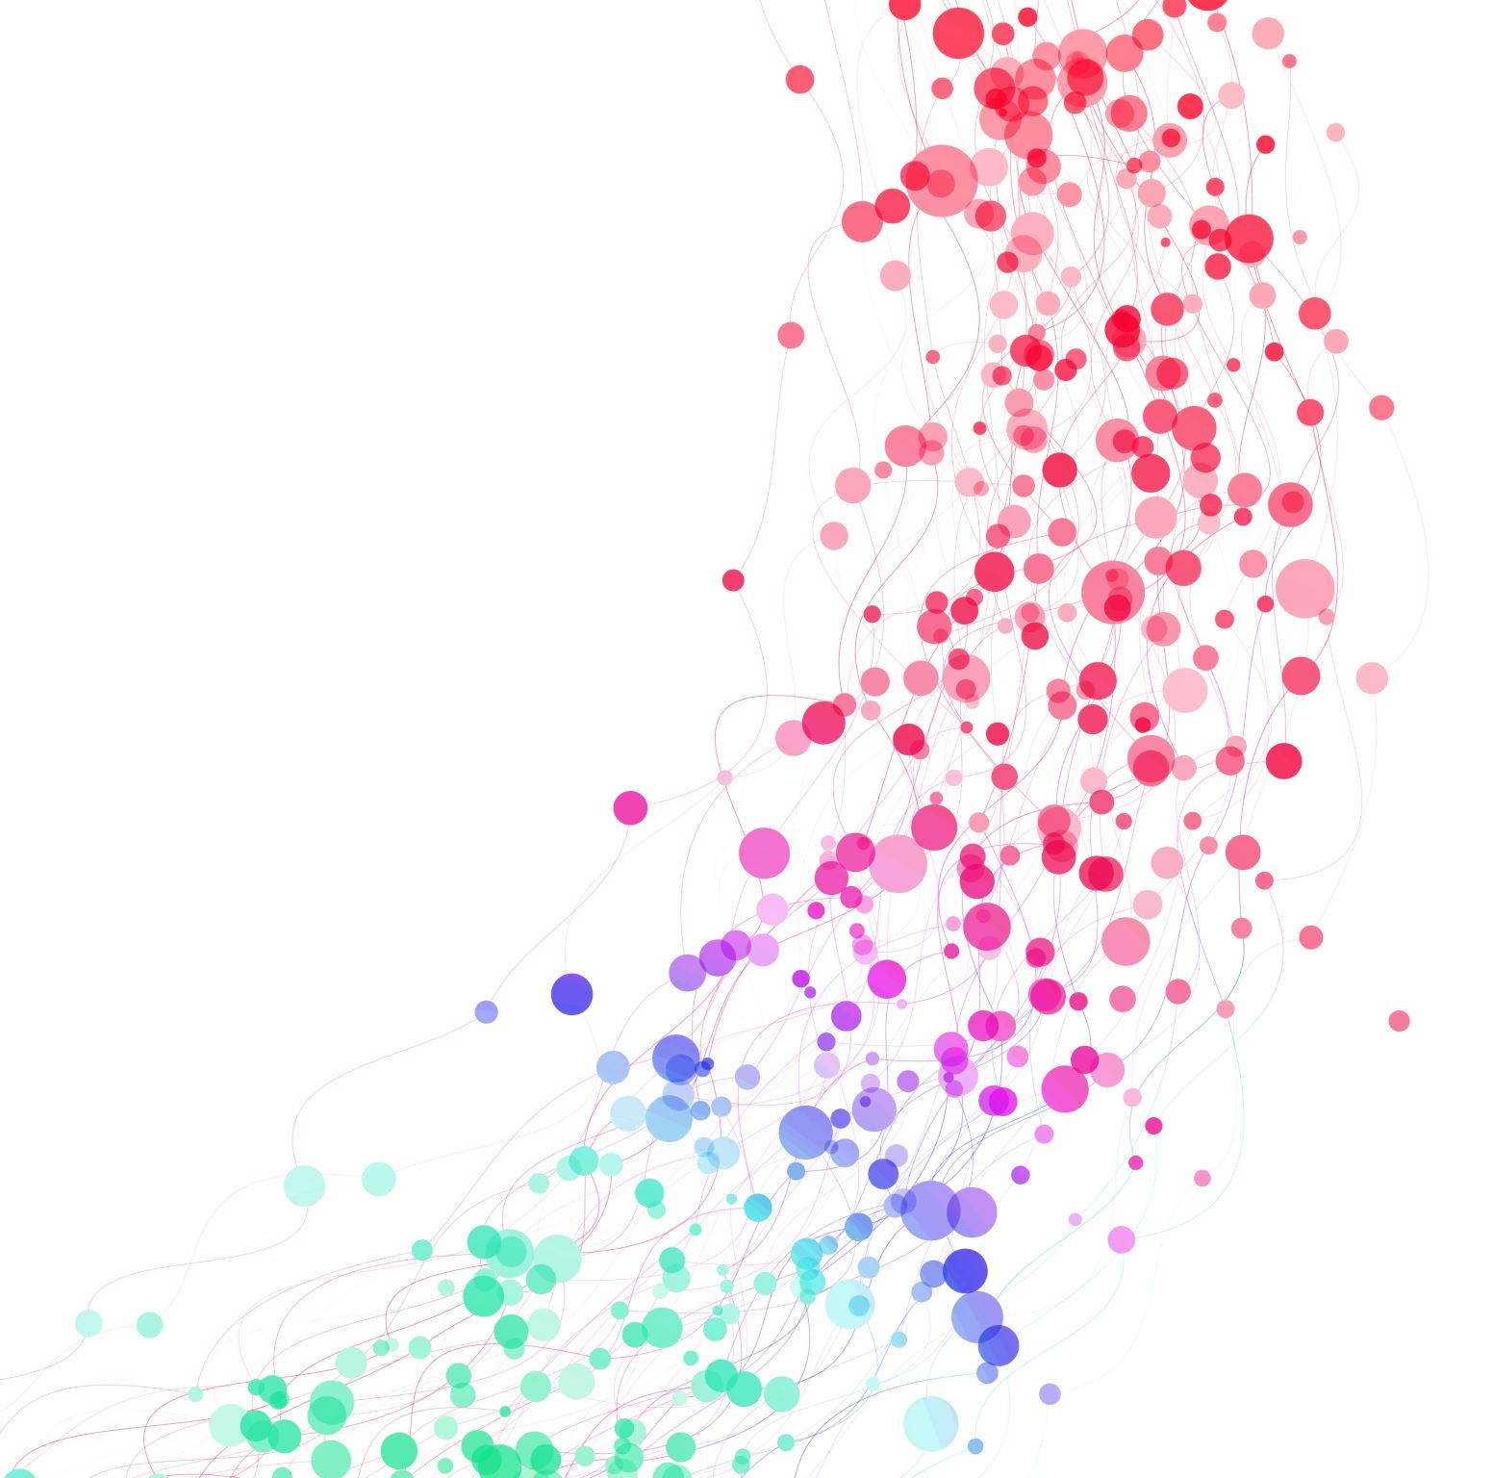
Automobile Insurance Complaints Analysis
Data Analysis project using MySQL and Power BI

Slide 2

Project Overview

Slide 3
Objective
The Automobile Insurance Complaints Analysis project was developed to analyze customer complaint data and identify meaningful insights using SQL and Power BI.
The project focuses on understanding complaint trends, comparing insurance companies, analyzing complaint categories, and presenting the findings through an interactive dashboard to support better business decisions.

Slide 4
Project Objectives
Analyze automobile insurance complaint data.
Clean and prepare the dataset using SQL.
Perform data analysis using SQL queries.
Create an interactive Power BI dashboard.
Identify complaint trends and company performance.
Generate business insights and recommendations.

Slide 5
Problem Statement
Insurance companies receive a large number of customer complaints related to claims, policy services, billing, and customer support. Without proper analysis, it becomes difficult to identify recurring issues, compare company performance, and improve customer satisfaction.
This project aims to analyze automobile insurance complaint data to uncover trends, evaluate complaint patterns, and provide actionable insights through data visualization.

Slide 6
Key Business Questions
Which insurance companies receive the highest number of complaints?
What are the most common complaint categories?
How do complaint trends change over time?
Which companies perform better in complaint handling?
What insights can help improve customer service?

Slide 7
Dataset Overview
Attribute
Details
Automobile Insurance Complaints
Insurance
Structured Data
Consumer Complaint Dataset
MySQL
Power BI
Project_automobile_insurance
Dataset Name
Domain
Datatype
Source
Analysis Tool
Visualization Tool
Database

Slide 8
Dataset Attributes
NAIC (Company ID)
Company Name
Complaint Ratio
Upheld Complaints
Question of Fact Complaints
Not Upheld Complaints
Total Complaints
Premiums Written (in Millions)
Rank
Filing Year

Slide 9
Data Cleaning & Preparation using SQL
Imported the dataset into MySQL.
Removed duplicate records.
Identified and handled missing (NULL) values.
Standardized company names and text fields.
Verified data types and corrected formatting.
Validated the dataset for consistency and accuracy.

Slide 10
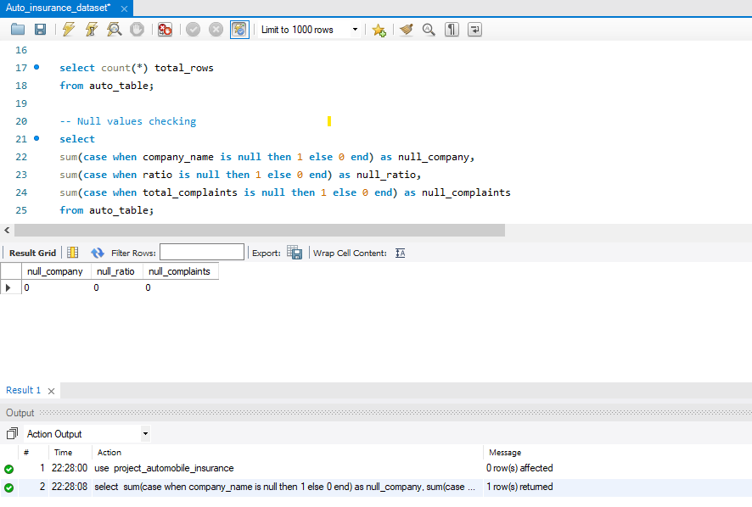

Slide 11
Dashboard Development
Dashboard Development Process
Imported the cleaned dataset into Power BI.
Performed data modeling and validation.
Created calculated measures and KPIs.
Designed interactive charts and visualizations.
Added filters (slicers) for dynamic data exploration.
Organized visuals into a professional dashboard layout.
Objective
Transform the cleaned dataset into an interactive dashboard for effective analysis and decision-making.

Slide 12
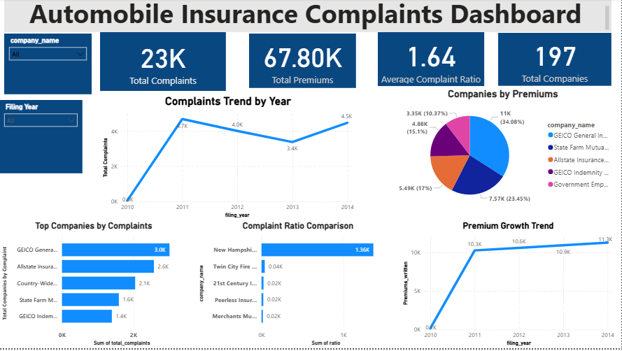

Slide 13
Power BI Dashboard Overview
Key Dashboard Components:
KPIs displaying total complaints and key performance metrics.
Line Chart showing complaint trends over time.
Bar Chart comparing complaints across insurance companies.
Pie Chart illustrating complaint distribution by category.
Slicers for interactive filtering and detailed analysis.

Slide 14
Key Insights
Identified companies with the highest number of complaints.
Analyzed complaint trends over time.
Compared complaint distribution across companies.
Highlighted major complaint categories.
Enabled quick identification of complaint patterns through interactive filter

Slide 15
Conclusion
Successfully analyzed automobile insurance complaints using SQL and Power BI.
Cleaned and prepared the dataset for accurate analysis.
Developed an interactive dashboard to visualize key complaint trends.
Identified valuable insights to support better business decisions.
Demonstrated the practical use of data analytics in solving real-world business problems.

Slide 16
Thank You

